Slide 1

DESIGN AND SIMULATION OF DC TO DC CONVERTER FOR PV SYSTEM
Team 1 – Nair Sabari Vijayan, Natasha Mujeeb Vayalil, Rushin Jaleel Shah, Vishnu B Menon
Guide – Ms. Rakhee R

Slide 2
PROBLEM IDENTIFICATION
Conventional Boost Converters operate with DC conversion ratios ranging from 3.42 to 6.85.
It also offers a maximum ratio of 10 when operated with a duty cycle of 0.9.
When it is operated in such conditions the converter tends to heat up and eventually break down.
This is not a desirable outcome that is expected from a converter.

Slide 3
PROPOSAL
To design and simulate a DC-DC Converter that has a higher conversion ratio than the conventional boost converters.
The converter is implemented by maintaining a lower duty cycle at a frequency of 25 kHz which in turn is expected to reduce the losses incurred.

Slide 4
OBJECTIVE
The objective of this project is to design and simulate a boost converter with improved conversion ratio for PV system.
Design of filter elements of improved converter.
Simulation of the circuit in MATLAB.
Obtaining the desired output from the simulation.
Implementing the prototype of the designed converter.
Ensuring similar results with that of the simulation.

Slide 5
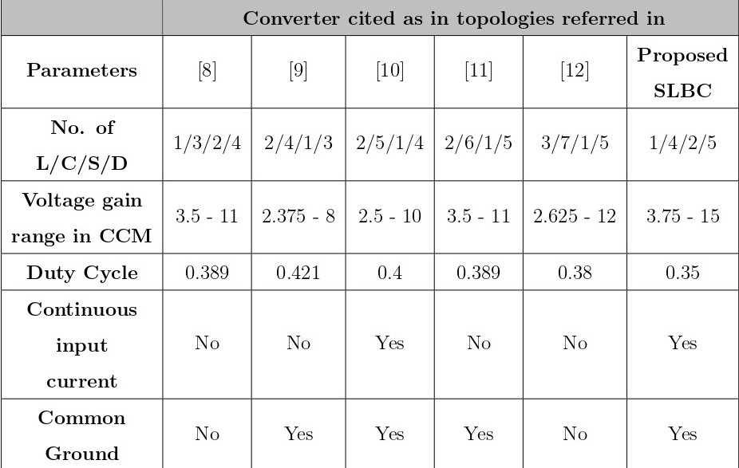
LITERATURE SURVEY OUTCOME

Slide 6
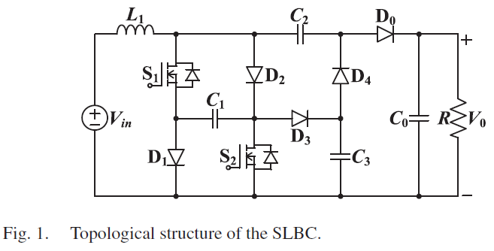
DETAILED CIRCUIT CONNECTION DIAGRAM

Slide 7
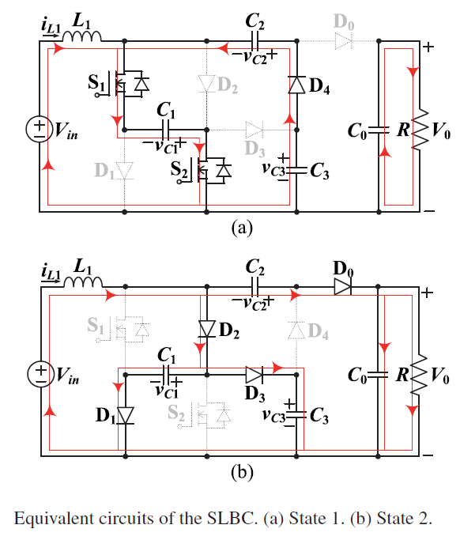
Fig.2.

Slide 8
Based on the aforementioned operational analyses in state 1, corresponding voltage expressions of the SLBC are listed as follows:
Similarly, the obtained voltage equations in state 2 are as follows:
V_{L1} = V_{in} + V_{C1}
V_{C} = V_{C1} + V_{C3}
(1)
V_{L1} = V_{in} + V_{C2} - V₀
V_{C1} = V_{C3} = V₀ - V_{C2}
(2)

Slide 9
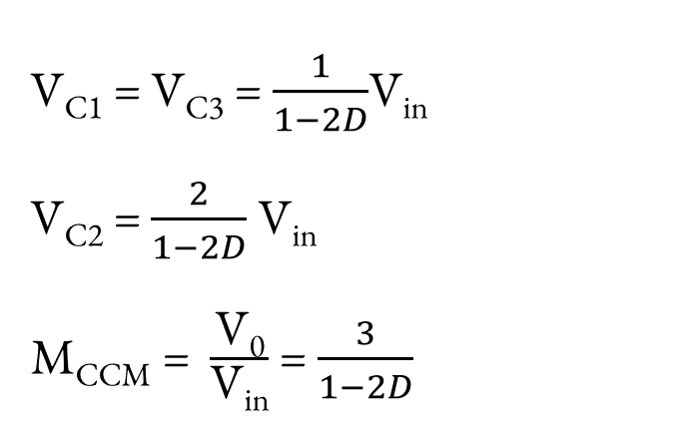
For L1, adopting the volt-second balance and integrating related capacitor voltages in (1) and (2), the derived mid-capacitor voltages and voltage gain of the SLBC are as follows:
(3)
(4)
(5)

Slide 10
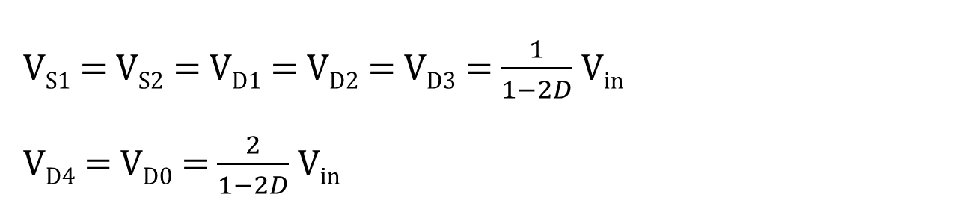
From (3) to (5), it is clear that the operational duty cycle range of the SLBC is 0<D<0.5.Within this range, the SLBC realize low mid-capacitor voltages and ultrahigh voltage gain.
When the switches or the diodes are OFF, the voltage stress across them can be obtained as follows:
(6)
(7)

Slide 11
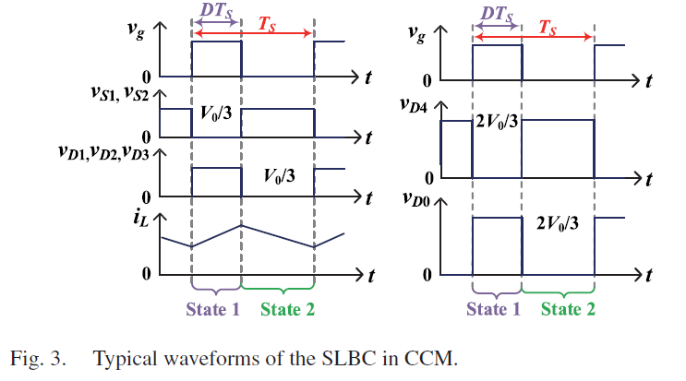

Slide 12
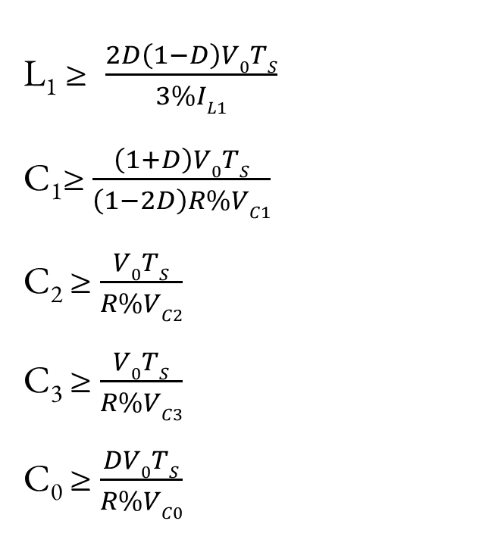
DESIGN CALCULATION

Slide 13
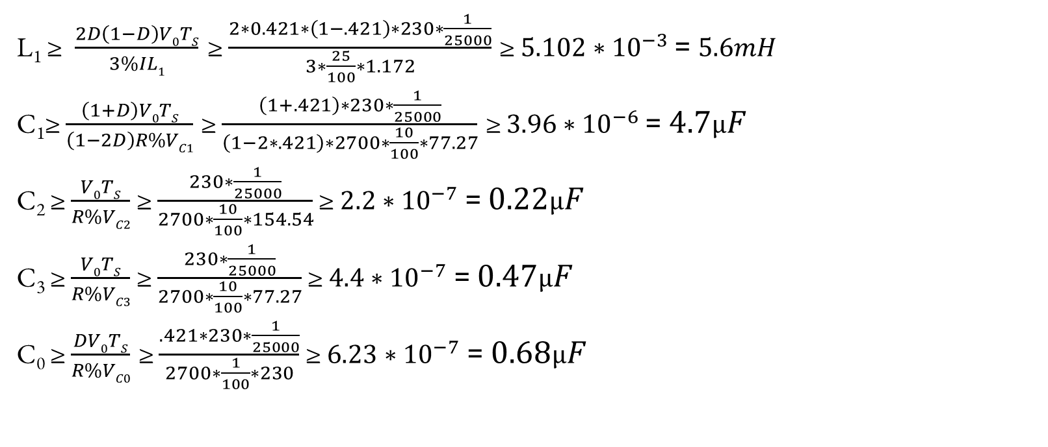
L₁,C₁,C₂,C₃,C₀ CALCULATION

Slide 14
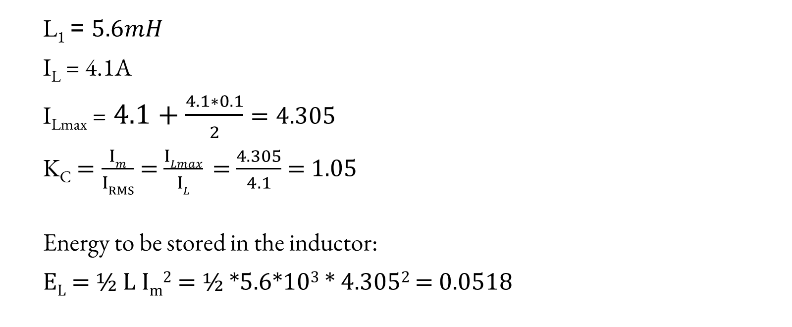
INDUCTOR WINDING CALCULATION

Slide 15
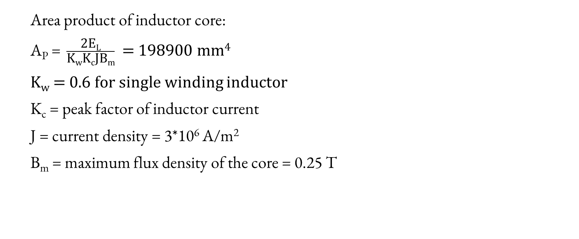

Slide 16
From table:
A_{P} = 142842 mm⁴
L_{m} = 150 mm
A_{c} = 537 mm
A_{w} = 266 mm
Core = E65/32/13

Slide 17
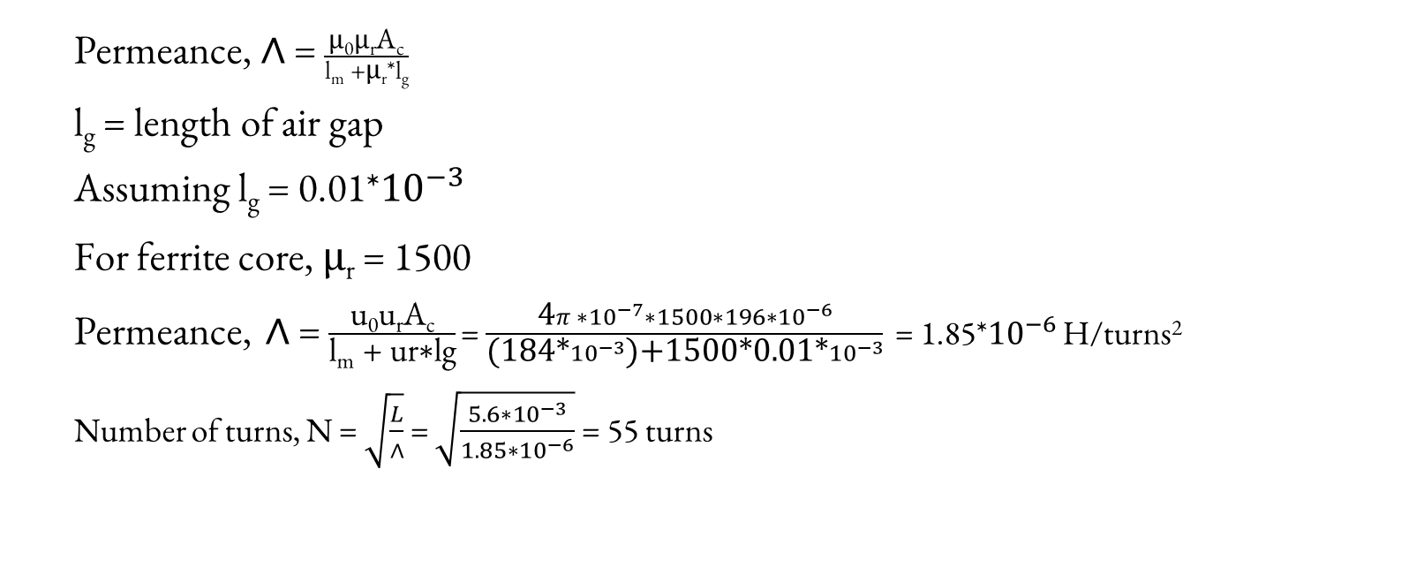

Slide 18
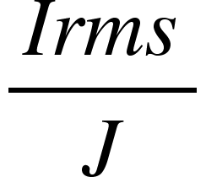
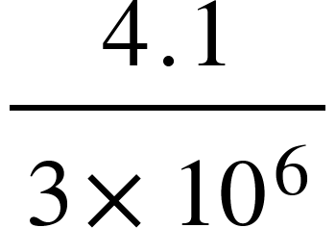

To calculate the size of copper wire,
Area of cross section of copper wire, a =
=
From the table
Area of copper wire = 1.589
Corresponding diameter of enamel = 1.509
Suitable gauge = 17

Slide 19
From calculations a suitable gauge of 17 was obtained. But due to the difficulty in winding of this wire due to its thickness, a wire guage of 22 was chosen to properly wind the inductor.
The number of turns was found to be around 30 turns, to get an inductance of 5.6mH

Slide 20
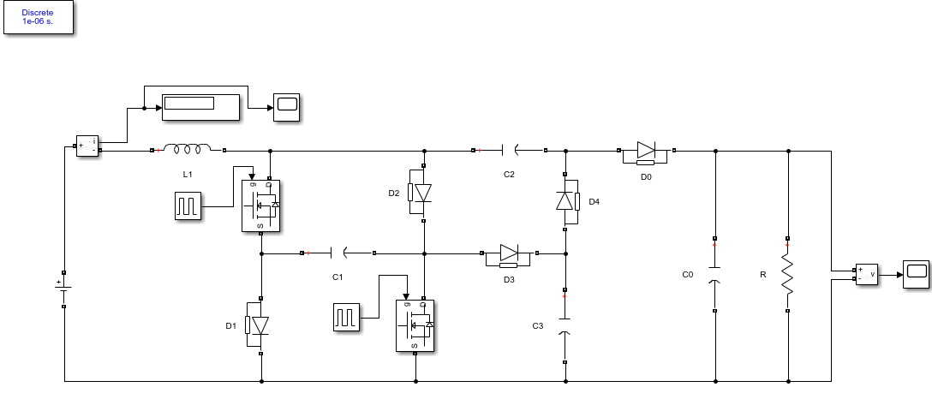
SIMULATION RESULTS

Slide 21
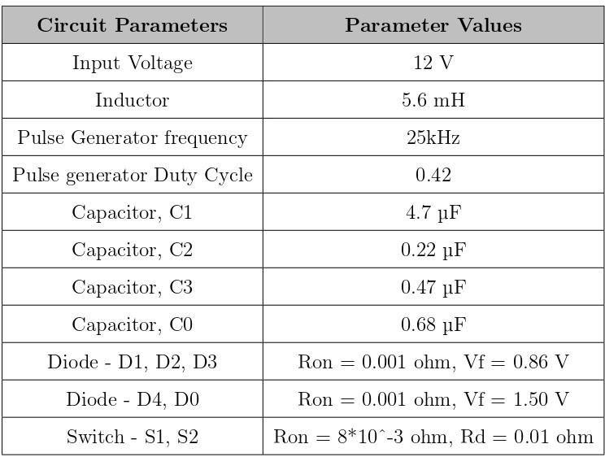

Slide 22
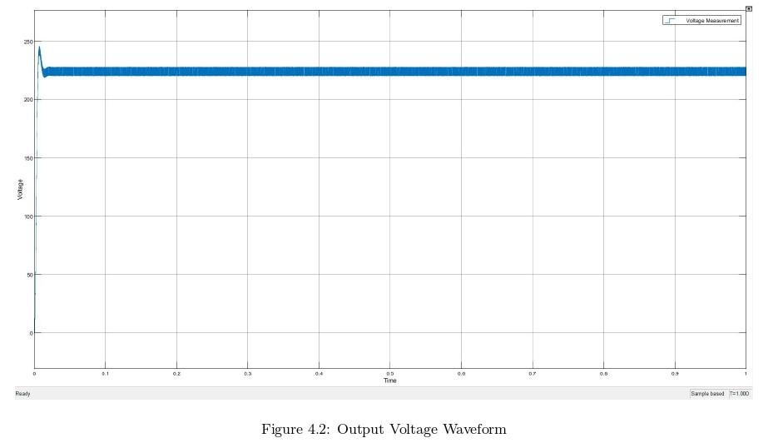

Slide 23
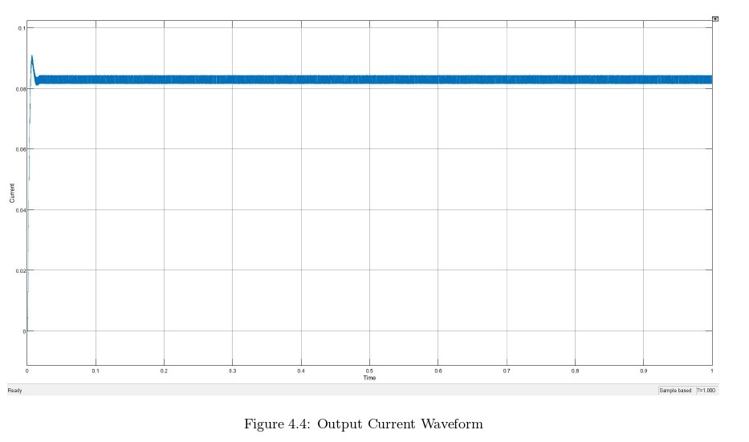

Slide 24
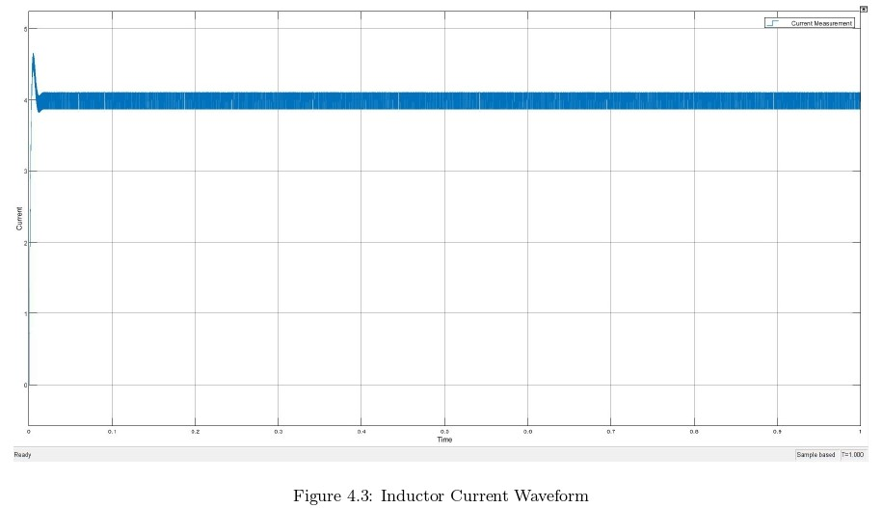

Slide 25
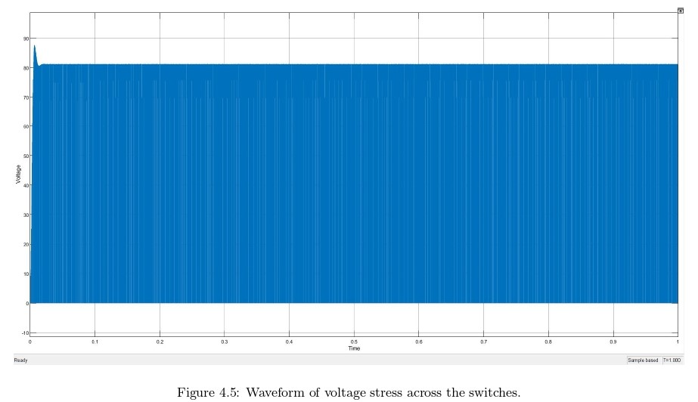

Slide 26
HARDWARE COMPONENT SPECIFICATIONS
The working conditions for the SLBC are set as follows.
1) Input voltage: Vin = 12 V.
2) Output voltage: V0 = 230 V.
3) Output power: P0 = 20 W
4) Switching frequency: fS = 25 kHz.
Corresponding duty cycle D = 0.421 and resistive load R = 2700 Ω. What’s more, on the basis of the above mentioned calculated stress, the choices of switches and diodes are as follows.
5) S1 and S2: IRFP4668PbF with VDSS = 200 V and ID = 130 A.
6) D1, D2 and D3: MBR20200CT with VRRM = 200 V and IF = 20 A.
7) D4 and D0: MUR1560 with VRRM = 600 V and IF = 15 A.
The ripple ratios for inductor L1, mid capacitors C1 to C3 and output capacitor C0 are set as 25%, 10%, and 1%, respectively.

Slide 27
Control circuit used for turning ON the switches by providing sufficient gate - source voltage and the frequency required is built using a gate driver(TLP250H). The switching frequency is created by programming an arduino to produce a switching pulse with a frequency of 25kHz.

Slide 28
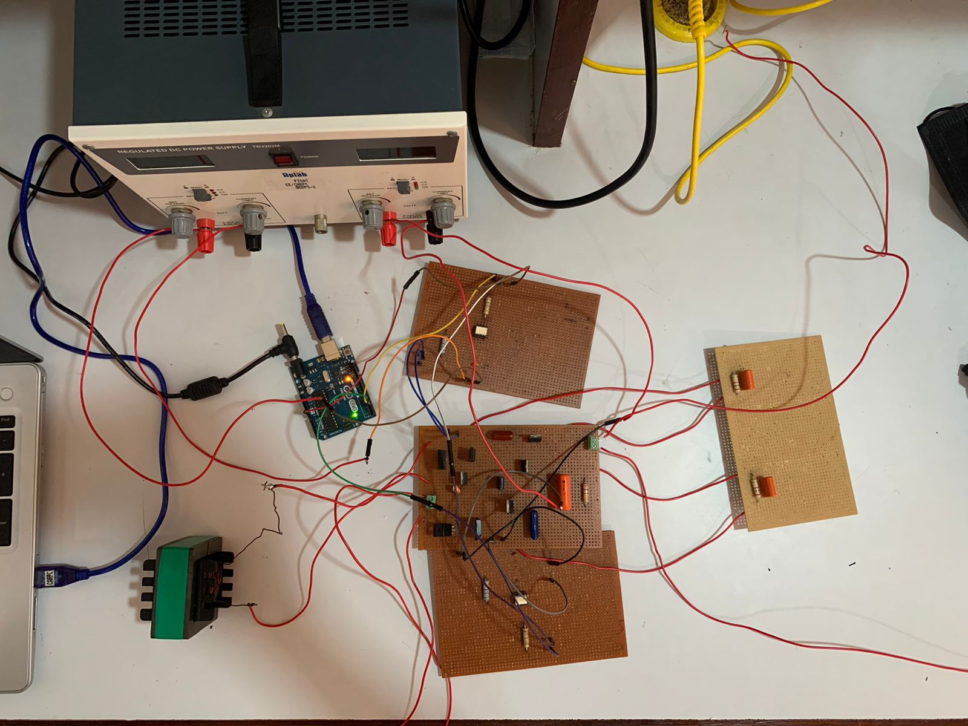
IMPLEMENTATION

Slide 29
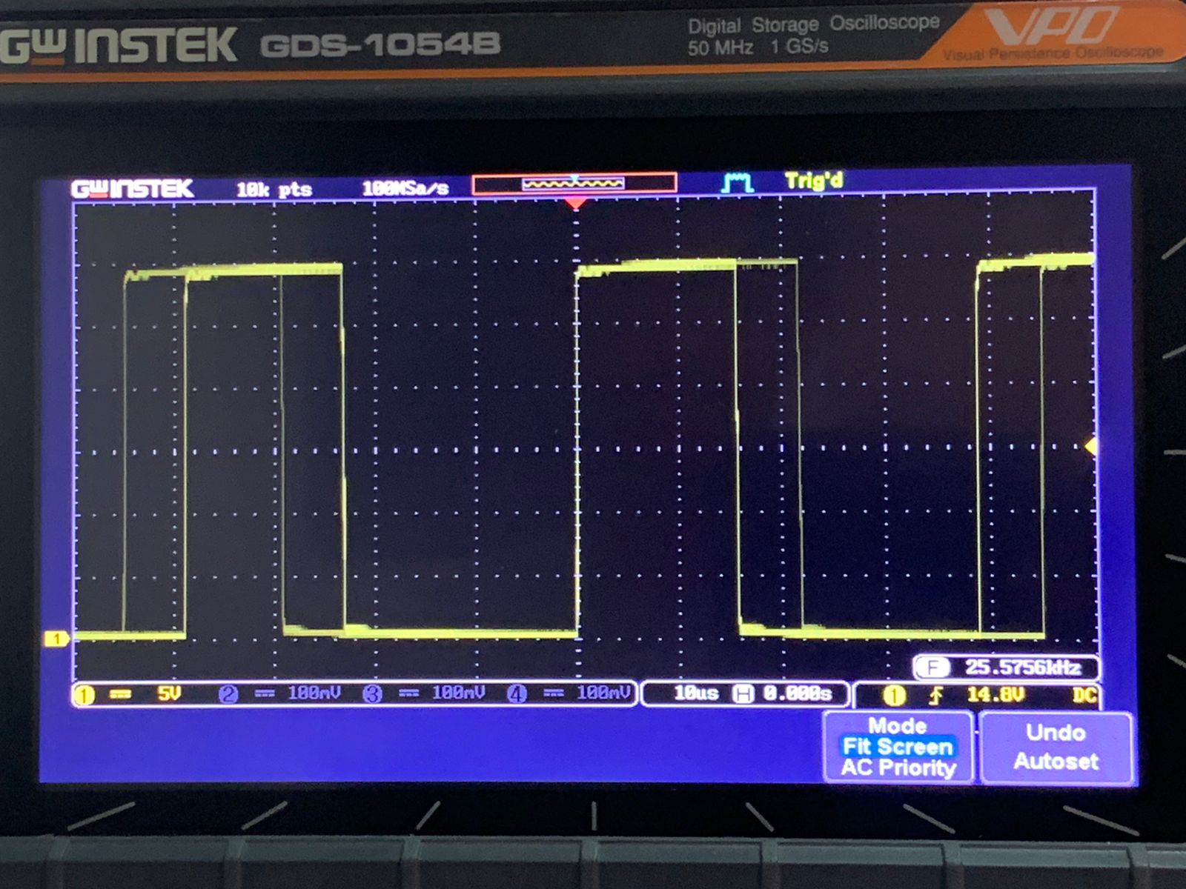
OBSERVATION
After running the simulation for a time period of 1 seconds an output of 227.6 V was observed with stress voltages across the switches being observed as around 87 V. The hardware implementation of the simulation was completed upto the gate drive pulse generation. The pulse generated was observed to have a value of 30 V and a frequency of 25 kHz in the digital oscilloscope as shown in figure.

Slide 30
CONCLUSION
The design and simulation of the proposed DC-DC converter has been done.The experimental implementation was completed up until the gate drive generation.
The simulation results were found to be satisfactory to that of the designed values of the converter. According to the simulation, this DC-DC converter has the following features:
1. Ultrahigh voltage boosting capability without using transformer or coupled inductor
2. Lower switching losses
3. Simple topological structure
4. Continuous input current
These converters can also be used in applications that desire high voltage gain, high efficiency, high power density, and high reliability.

Slide 31
FUTURE SCOPE AND POSSIBLE IMPROVEMENTS
The proposed converter has a very low current output, thus to increase the output amperes many panels can be connected in parallel to make up for it to be used to supply an equipment that requires more current.
Other trending technologies like solar tracking and MPPT control can be applied to get maximum Power point tracking so as to ensure the panel produces maximum voltage and current at each maximum power point for the corresponding irradiance.

Slide 32
REFERENCES
[1] Shan Miao, Wei Liu, and Jinfeng Gao. Single-inductor boost converter with ultrahigh step-up gain, lower switches voltage stress, continuous input current, and common grounded structure. IEEE Transactions on Power Electronics, 36(7):7841–7852, 2020.
[2] Niraj Rana, Jayati Dey, and Subrata Banerjee. An improved buck-boost converter suitable for pv application. In 2020 IEEE Calcutta Conference (CALCON), pages 273–277. IEEE, 2020.
[3] Jian Fu, Bo Zhang, Dongyuan Qiu, and Wenxun Xiao. A novel single switch cascaded dc-dc converter of boost and buck-boost converters. In 2014 16th European Conference on Power Electronics and Applications, pages 1– 9. IEEE, 2014.
[4] X. Hu, J.Wang, L. Li, and Y. Li, “A three-winding coupled-inductor dc-dc converter topology with high voltage gain and reduced switch stress,” IEEE Trans. Power Electron., vol. 33, no. 2, pp. 1453–1462, Feb. 2018.
[5] A. M. S. S. Andrade, L. Schuch, and M. L. S. Martins, “Analysis and design of high-efficiency hybrid high step-up dc-dc converter for distributed PV generation systems,” IEEE Trans. Ind. Electron., vol. 66, no. 5, pp. 3860–3868, May 2019.
[6] A. M. S. S. Andrade and M. L. S. Martins, “Study and analysis of pulsating and non-pulsating input and output current of ultrahigh-voltage gain hybrid dc-dc converters,” IEEE Trans. Ind. Electron., vol. 67, no. 5, pp. 3776–3787, May 2020.

Slide 33
[7] Bilal Ahmad, Jorma Kyyra, and Wilmar Martinez. Efficiency optimisation of an interleaved high step-up converter. The Journal of Engineering, 2019(17):4167–4172, 2019. 23
[8] M.-K. Nguyen, T.-D. Duong, and Y.-C. Lim, “Switched-capacitor-based dual-switch high-boost dc-dc converter,” IEEE Trans. Power Electron., vol. 33, no. 5, pp. 4181–4189, May 2018.
[9] S. Rostami, V. Abbasi, and F. Blaabjerg, “Implementation of a common grounded Z-source dc-dc converter with improved operation factors,” IET Power Electron., vol. 12, no. 9, pp. 2245–2255, Sep. 2019.
[10] Y. Zhang, C. Fu, M. Sumner, and P. Wang, “A wide input-voltage range quasi-Z-source boost dc-dc converter with high-voltage gain for fuel-cell vehicles,” IEEE Trans. Ind. Electron., vol. 65, no. 6, pp. 5201–5212, Jun. 2018.
[11] P. Kumar and M. Veerachary, “Z-network plus switched-capacitor boost dc-dc converters,” IEEE J. Emerg. Sel. Topics Power Electron., to be published.
[12] M. M. Haji-Esmaeili, E. Babaei, and M. Sabahi, “High step-up quasi-Z source dc-dc converter,” IEEE Trans. Power Electron., vol. 33, no. 12, pp. 10563–10571, Dec. 2018.

Slide 34
THANK YOU
Team 1 – Nair Sabari Vijayan, Natasha Mujeeb Vayalil, Rushin Jaleel Shah, Vishnu B Menon
Guide – Ms. Rakhee R

